Slide 1
Microsoft Student Starter Pack
Speaker: Kenji Phang
Notes:
Hi everyone, welcome to the first student ambassador and student in person meetup event, its nice to see people out on a Tuesday evening, without further ado, lets begin the talk

Slide 2

Kenji.Info
Beta Microsoft Learn Ambassador
CS Student from the University of Manchester
Doing a placement as a Fullstack Engineer at Interact Software
Interests: .NET and Azure
Notes:
Let me first introduce myself, I’m Kenji, a beta Microsoft learn student ambassador, I’m studying computer science at the university of Manchester and I’m currently doing my placement as a fullstack engineer at Interact software.
I sound like I have a few things under my belt now, but to be honest, just one year ago, I was just an average university student, I wasn’t doing anything more than what was necessary to pass my first year, didn’t do much side projects or hackathons, I knew that I wanted to pursue a career in technology but to be honest, I wasn’t even sure where to even start, I was lost and spent a lot of time figuring out my path

Slide 3
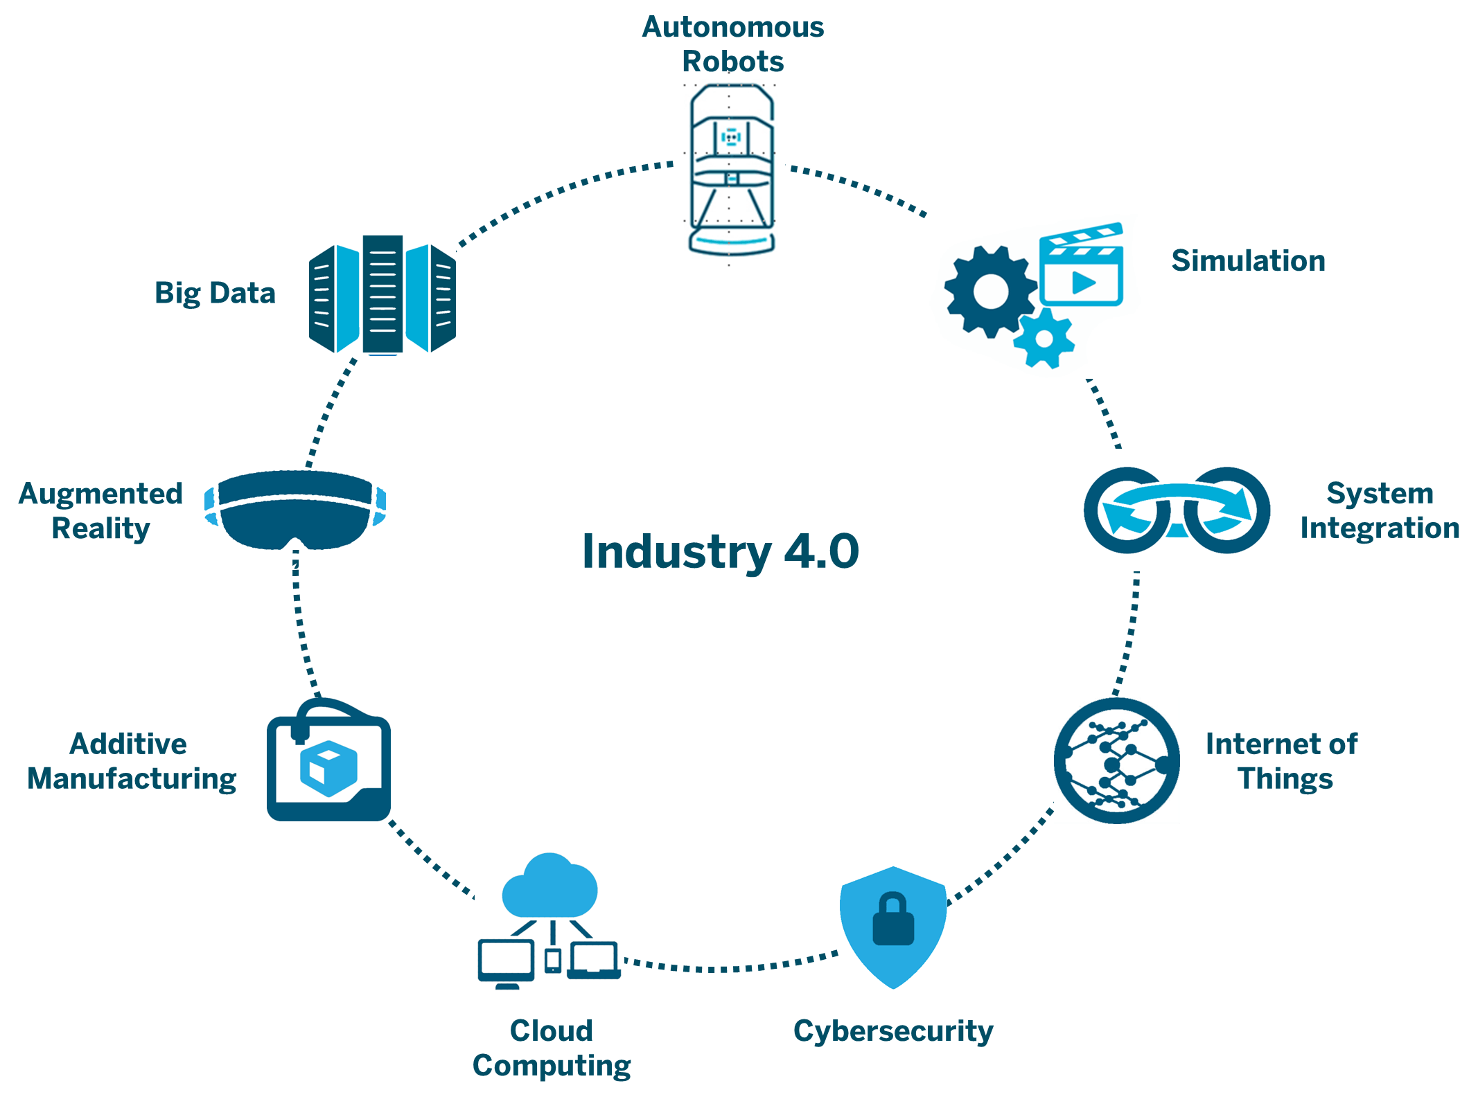
Technology is overwhelming
Notes:
Let’s just dive straight to the problem here, that is technology is just so overwhelming. A career in tech is very flexible, you can get into pretty much any industry with a STEM degree, every industry needs technology right? As you can see, we are heading into industry 4.0, there are tons of options to pursue. But the tradeoff is that there are just so many options and choices to consider, you might be asking yourself:
How do I find out which field is right for me?
Which fields should I try out first?
Where can I learn about this
Do I even have time to try everything?

Slide 4
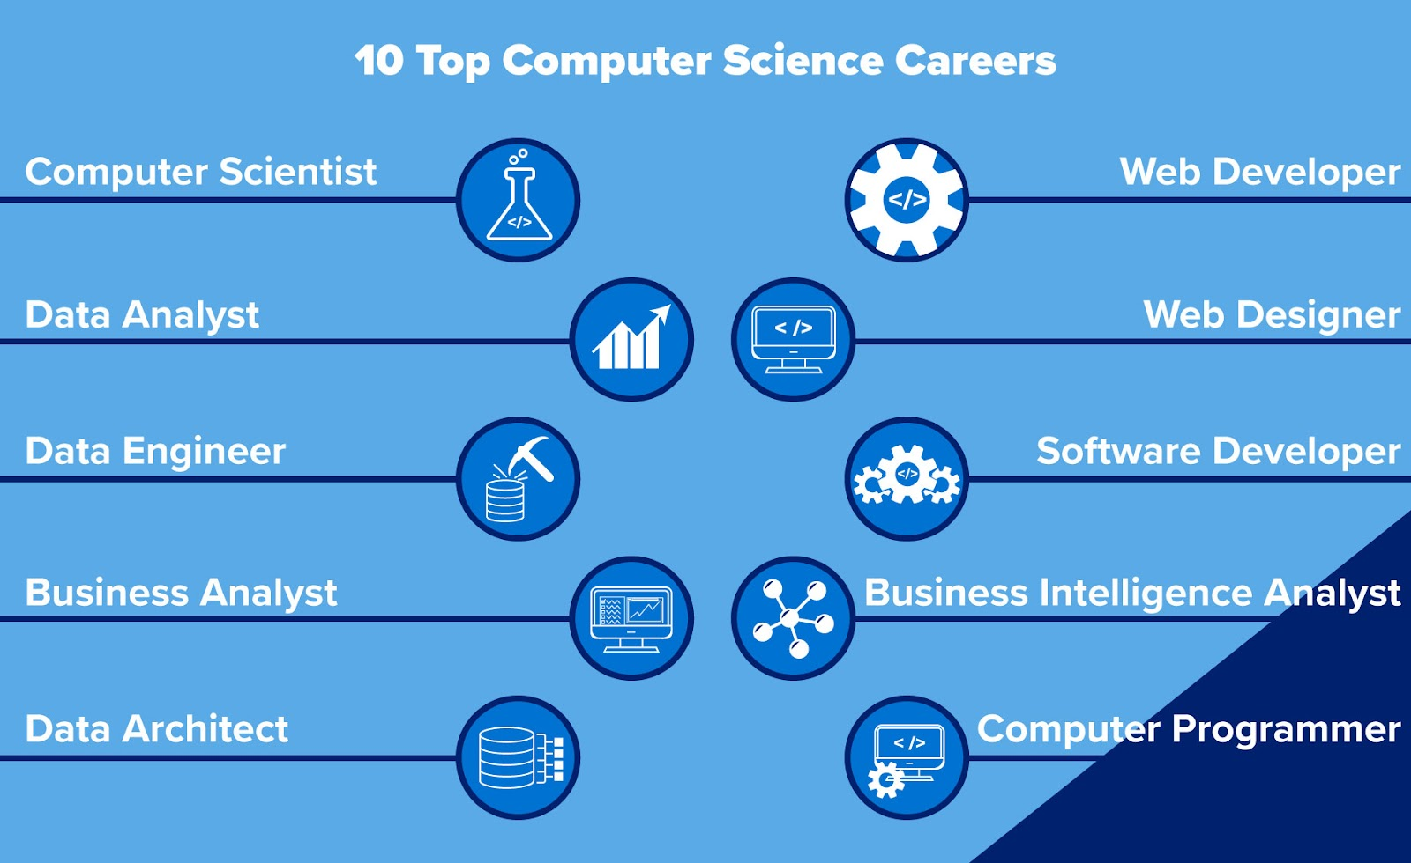
Job roles are overwhelming
Notes:
Here is another consideration. What role is right for me? Do I want to be a dev? A data analyst? The worst feeling is when you don’t even know that the role exists? I didn’t know what a cloud architects is until I joined the ambassadors

Slide 5
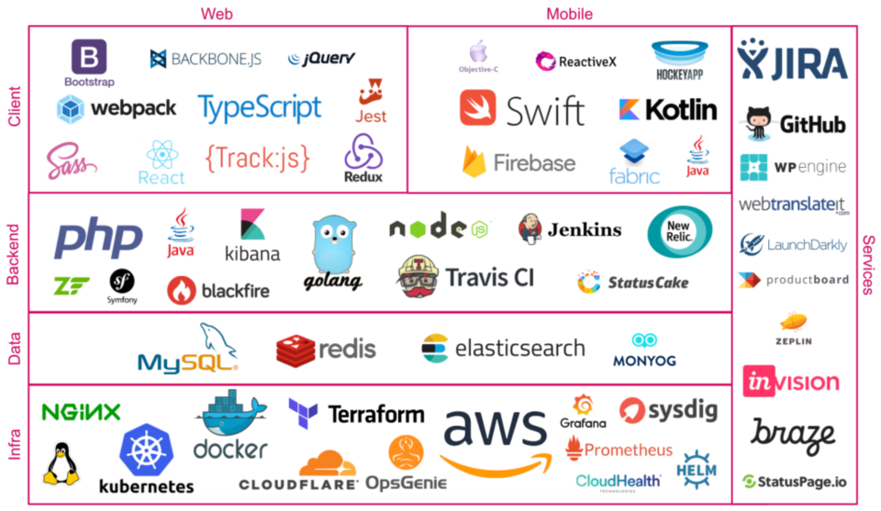
Tech stacks are overwhelming
Notes:
Even after you’ve have decided the field or role, you are still bombarded with the options for the tools. There are so many tools that can be used to solve the same problem

Slide 6
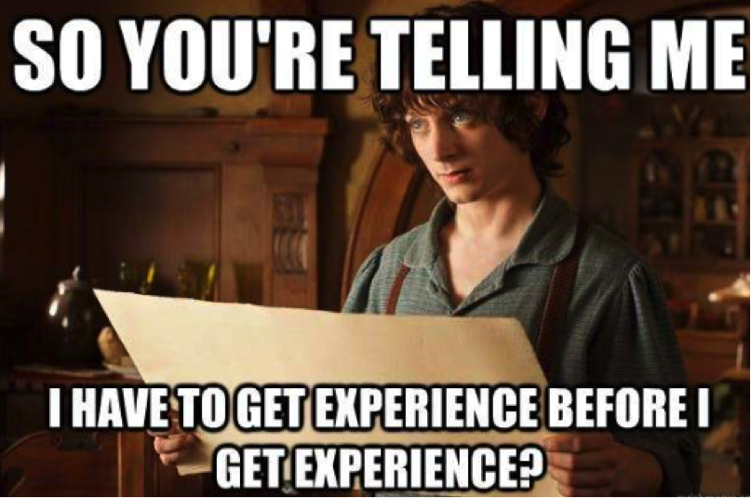
How do I get hired?
Notes:
And that’s not all, you still have to think about how you can get the job itself, you have to be competitive, you need to find ways to make you and your CV stand out. If you are a student looking for a summer internship or taking a placement year, you somehow have to get all of this figured out even earlier, how is a student supposed to do all this? No one knows

Slide 7







The (unofficial) Microsoft Student Starter Pack
Notes:
I went through all of that myself and let me tell you, its not enjoyable. To save you all some time and sanity, I want to share with you all what I call the Microsoft student starter pack. This pack basically consists of the tools, resources and student opportunities you can take advantage of from Microsoft and its subsidiary companies. If you are new to technology, this would be a good place to start and if you have already been doing some stuff, here are some things that can enhance and accelerate your developer journey.

Slide 8
Microsoft Learn
Notes:
The first thing we will look at is Microsoft Learn. Its Microsoft’s own learning platform where everyone has access to knowledge from cloud computing to software engineering to even non technical stuff. The content here are taught through individual modules, which usually takes around an hour long, and there is a knowledge test at the end of each module to reinforce the knowledge.
The nice thing about Microsoft Learn is that there are predefined pathways for you to follow to help you navigate through the content. There is also a gamification system where you can get badges and trophies for completing modules and there are also challenges every once in a while where you have a chance to win something if you complete them.

Slide 9
Azure for Students
Notes:
Next is Azure for Students. Azure is of course Microsoft’s cloud computing platform and deploying resources on Azure

Slide 10
Microsoft Exams
Notes:
The first tool we will look at is GitHub. This is a source control tool, if you are not familiar with git, git provides collaboration between software engineers, your source code is stored in a remote server and multiple software engineers can work on applying changes at the same time.

Slide 11
GitHub
Notes:
The first tool we will look at is GitHub. This is a source control tool, if you are not familiar with git, git provides collaboration between software engineers, your source code is stored in a remote server and multiple software engineers can work on applying changes at the same time.

Slide 12
GitHub Student Developer Pack
Notes:
The first tool we will look at is GitHub. This is a source control tool, if you are not familiar with git, git provides collaboration between software engineers, your source code is stored in a remote server and multiple software engineers can work on applying changes at the same time.

Slide 13
Visual Studio Code
Notes:
The first tool we will look at is GitHub. This is a source control tool, if you are not familiar with git, git provides collaboration between software engineers, your source code is stored in a remote server and multiple software engineers can work on applying changes at the same time.

Slide 14
Visual Studio
Notes:
The first tool we will look at is GitHub. This is a source control tool, if you are not familiar with git, git provides collaboration between software engineers, your source code is stored in a remote server and multiple software engineers can work on applying changes at the same time.

Slide 15
Microsoft Learn Student Ambassadors
Notes:
The first tool we will look at is GitHub. This is a source control tool, if you are not familiar with git, git provides collaboration between software engineers, your source code is stored in a remote server and multiple software engineers can work on applying changes at the same time.

Slide 16
GitHub Campus Experts
Notes:
The first tool we will look at is GitHub. This is a source control tool, if you are not familiar with git, git provides collaboration between software engineers, your source code is stored in a remote server and multiple software engineers can work on applying changes at the same time.

Slide 17
Imagine Cup
Notes:
The first tool we will look at is GitHub. This is a source control tool, if you are not familiar with git, git provides collaboration between software engineers, your source code is stored in a remote server and multiple software engineers can work on applying changes at the same time.

Slide 18
Linkedin
Notes:
The first tool we will look at is GitHub. This is a source control tool, if you are not familiar with git, git provides collaboration between software engineers, your source code is stored in a remote server and multiple software engineers can work on applying changes at the same time.

Slide 19
Linkedin Learning
Notes:
The first tool we will look at is GitHub. This is a source control tool, if you are not familiar with git, git provides collaboration between software engineers, your source code is stored in a remote server and multiple software engineers can work on applying changes at the same time.

Slide 20




Takeaway
Do something
Learn something
With
Share it
Notes:
What should you takeaway from this talk? Technology is a fast and evolving field, there is always something new everyday. All you need to do is to do this, learn something, doing something with it, use the tools when necessary, share the results on Linkedin, repeat and you will succeed. You have to remember that being good a good developer isn’t a destination, it is a journey. So be ready to learn something new everyday

Slide 21
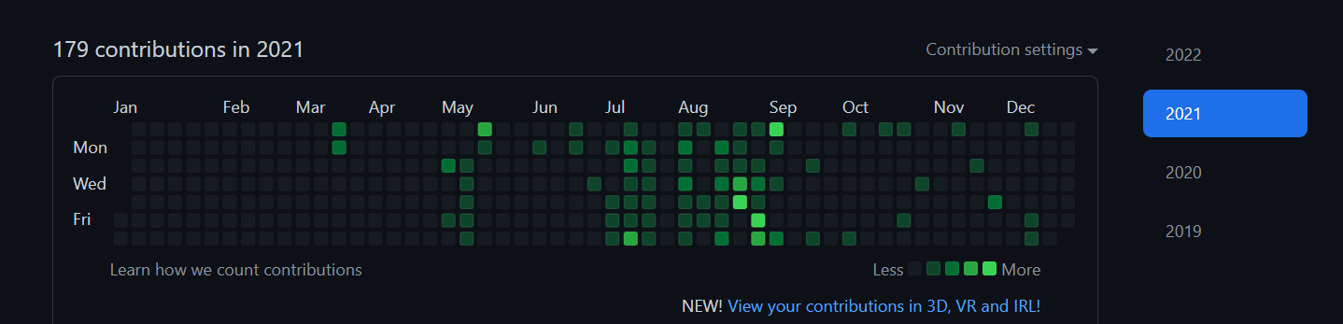
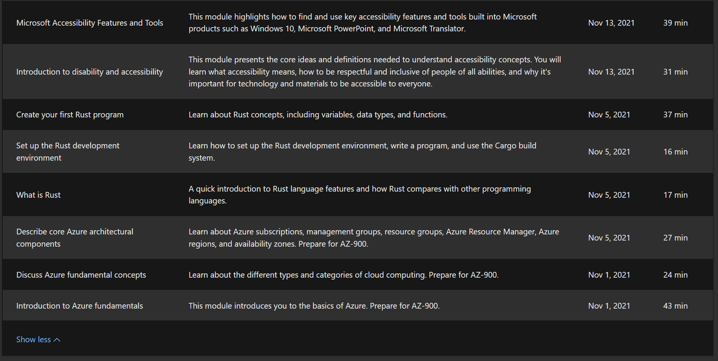
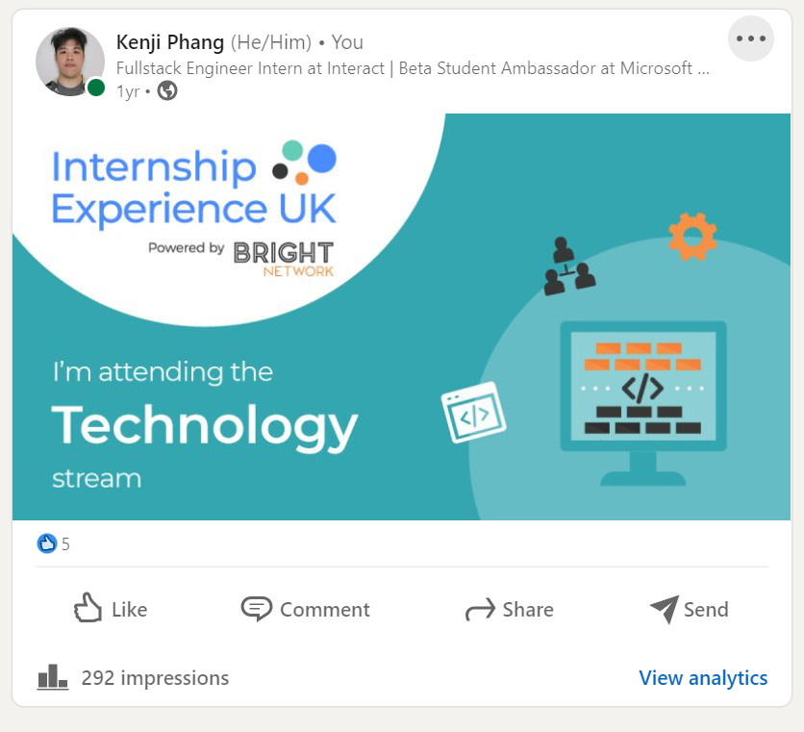
It works – One year ago
Notes:
This worked for me, just one year ago, I started using GitHub actively, started doing some learn modules and also started using Linkedin actively

Slide 22
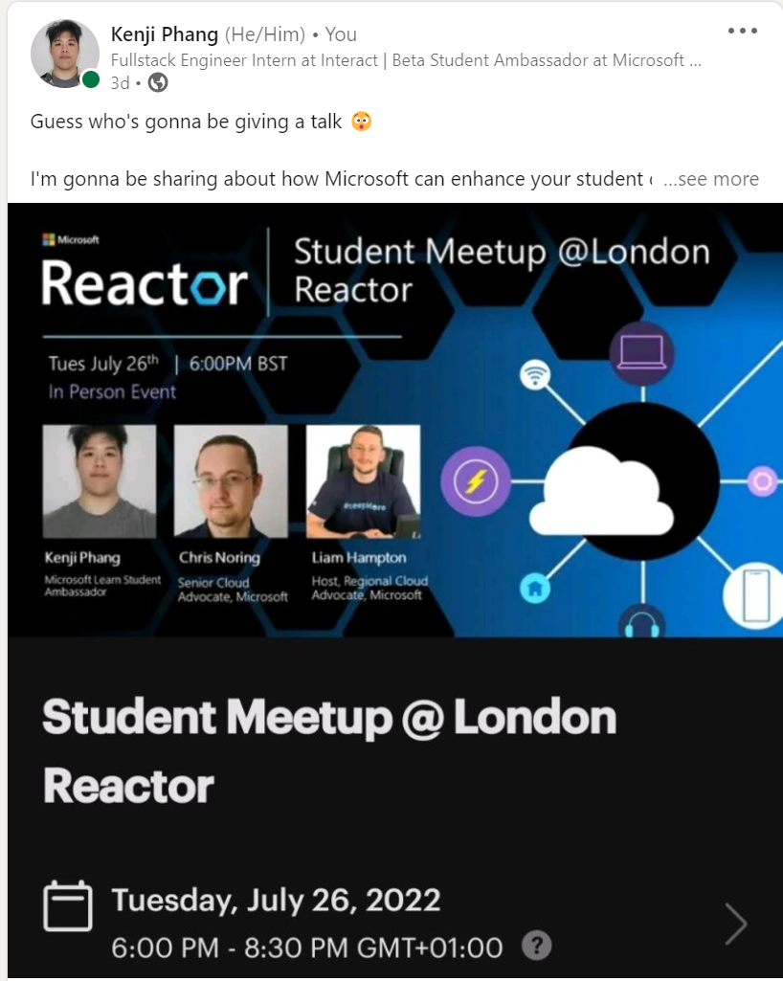



It works – Now
Notes:
One year later, I have a job and I am giving a talk here at the Microsoft Reactor

Slide 23
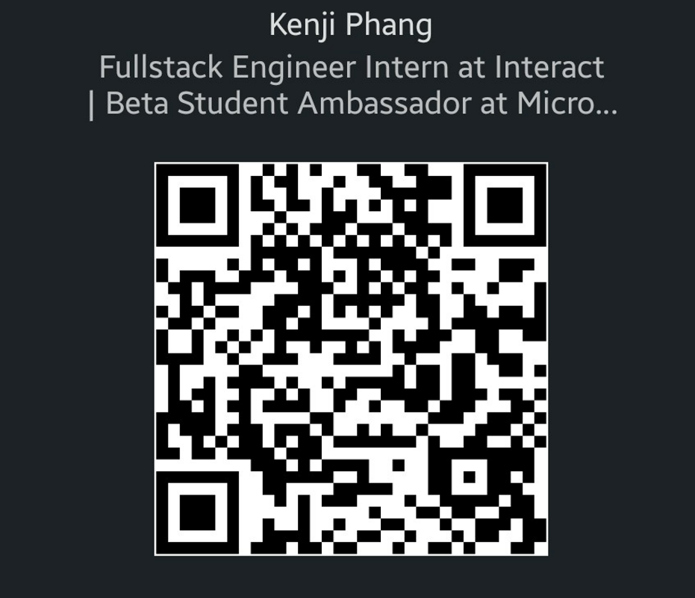
Thanks for listening
LinkedIn
GitHub Repo
Notes:
All right, that’s it from me, I’ve made a GitHub Repo containing the contents of this talk, feel free to share it around. I didn’t have time to include a QnA session so if you all have any questions about any of the tools, the ambassadorship program or anything else, feel free to just ask me, I’ll be at the corner somewhere. Thank you for listening, remember to keep on learning.

